Slide 1
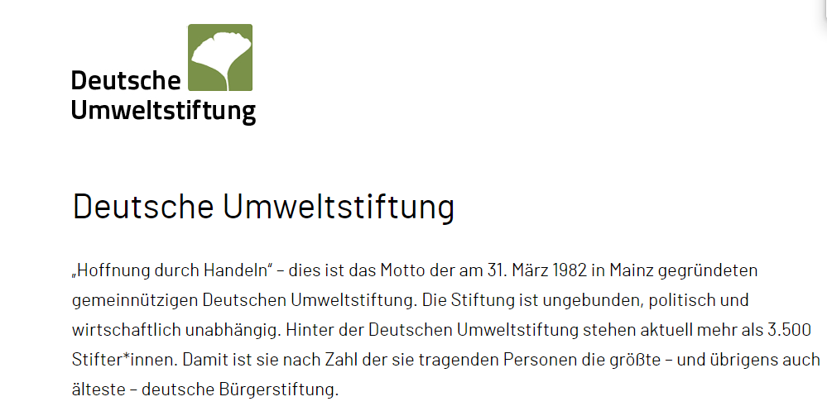

Slide 2
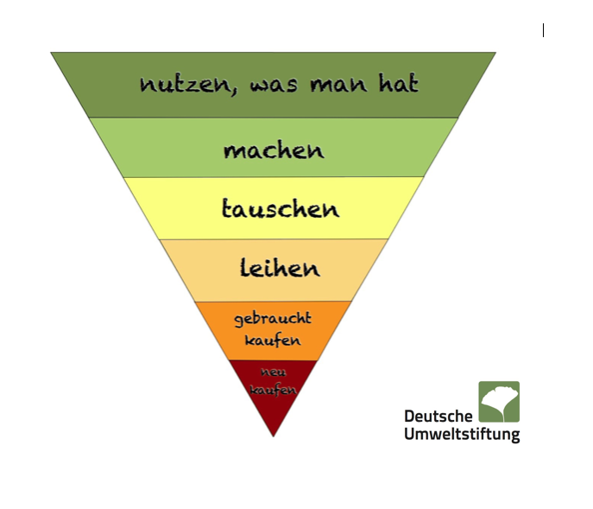

Slide 10
ESG
SMR
Green Taxonomy

